Slide 2
DevOps For .NET Core Devs
Zachary Deptawa
@zdeptawa

Slide 3

WHAT IS DEVOPS?
It’s a job title
It’s automation
It’s Development and Operations collaboration
It means faster and smaller releases
@zdeptawa

Slide 4


DevOps is the union of people, process, and products to enable continuous delivery of value to our end users.
- Donovan Brown
http://bit.ly/WhatIs-DevOps
@zdeptawa

Slide 5
Why is DevOps Important?
Your competition is already doing this
Increase velocity
Reduce downtime
Reduce human error
@zdeptawa

Slide 6


High Performance DevOps Companies Achieve…
46x Deployment
Frequency
2,555x Faster Lead
Time For Changes
Faster
Time to Market
DevOps
$
Increased
Revenue
7x Lower Change
Failure Rate
2,604x Faster Mean
Time to Recover
@zdeptawa
Source: 2018 Accelerate: State of DevOps: Strategies for a New Economy." N. Forsgren, J. Humble, G. Kim. DevOps Research and Assessment (DORA)

Slide 7






DevOps: the three stage conversation
DEV
OPS
1
People
2
Process
3
Products
@zdeptawa

Slide 8


People
DEV
OPS
@zdeptawa

Slide 9
Process
1
4
Plan
Monitor + Learn
Development
Production
2
3
Develop + Test
Release
@zdeptawa

Slide 10
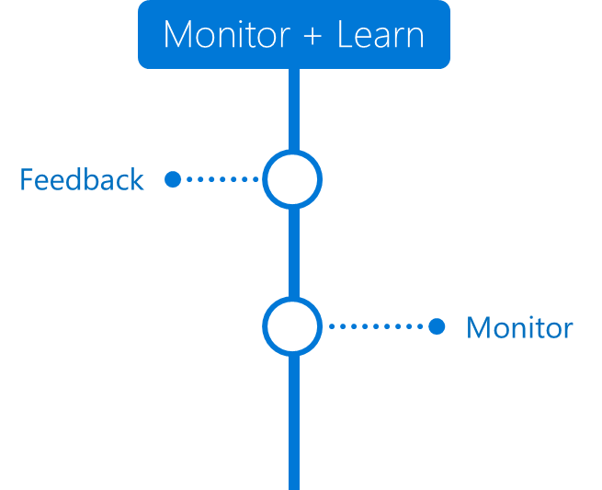




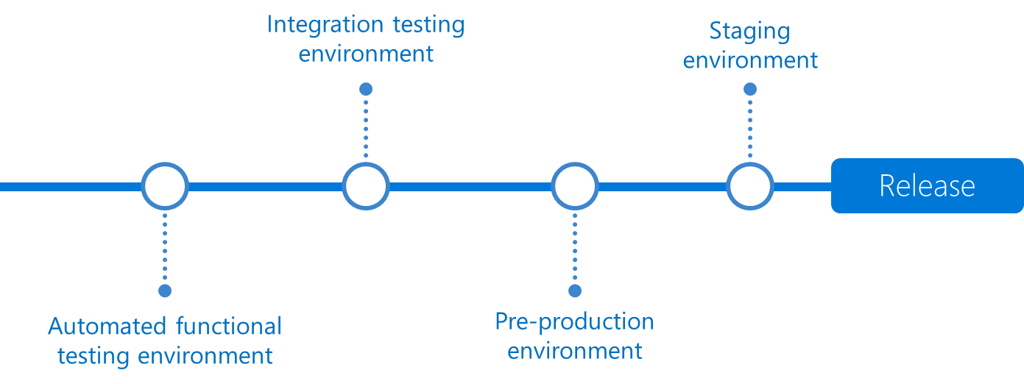



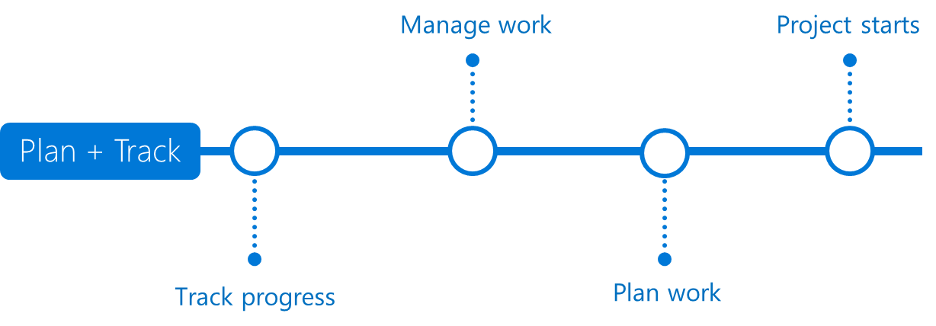








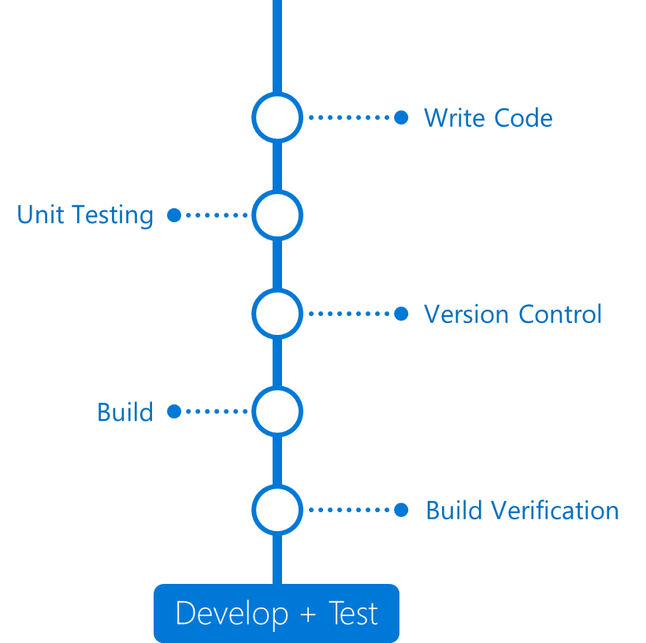












Any Language
Any Platform
DevOps
DevOps
@zdeptawa

Slide 11





Introducing Azure DevOps
Azure Boards
Azure Pipelines
Azure Repos
Deliver value to your users faster using proven agile tools to plan, track, and discuss work across your teams.
Build, test, and deploy with CI/CD that works with any language, platform, and cloud. Connect to GitHub or any other Git provider and deploy continuously.
Get unlimited, cloud-hosted private Git repos and collaborate to build better code with pull requests and advanced file management.
Azure Test Plans
Azure Artifacts
➔
Test and ship with confidence using manual and exploratory testing tools.
Create, host, and share packages with your team, and add artifacts to your CI/CD pipelines with a single click.
https://azure.com/devops
@zdeptawa

Slide 12


Azure DevOps + Azure
@zdeptawa

Slide 13


Connect With Me
Zachary Deptawa
Cloud Advocate
@zdeptawa

Slide 14




Azure DevOps
#AzureDevOps
https://azure.com/devops
@AzureDevOps
https://aka.ms/AzureDevOpsForum
https://aka.ms/DevOpsBlog/
@zdeptawa

Slide 15
Thank you!
Zachary Deptawa
@zdeptawa

